Slide 1
An automaton that is created from biological materials and resembles a human.

Slide 3
Android SDK Overview
Gururaj Parvati

Slide 4
Agenda
Android Architecture overview
Android SDK What is there?
Android C2DM
Android Media Framework
Bluetooth
Android 2.3 Enhancements
Graphics 2D/3D
Telephony

Slide 5
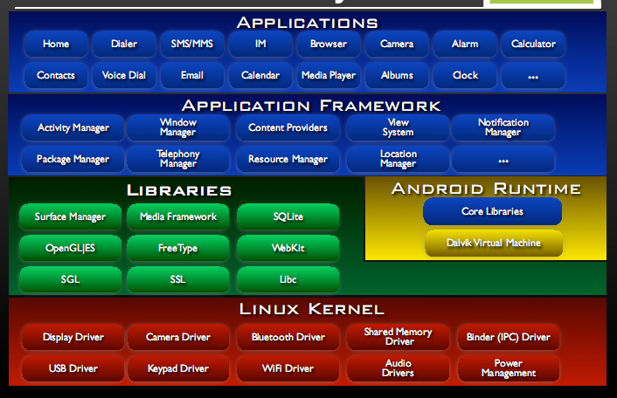
One picture we have all seen zillion times

Slide 6
Bottoms-up - Cheers
No native windowing system
No glibc support instead bionic libc with BSD license
Linux Device drivers
Android shared memory (Ashmem)
Binder IPC driver
New Power management

Slide 7
If you are not a good Citizen
You have developed a great APP! Cool.
When do you think users will un install your application?

Slide 8
Power management
1
2
3
4
5
6
7

Slide 9
Libraries
Bionic libc. BSD license.
Web kit support with Ajax, DOM, CSS and Java script support
Interface through Java
Surface manager – Handling UI Windows
2D and 3D graphics
Media codecs, SQLite, Browser engine
Notes:
Freetype is for the font rendering
Surface manager for pixel rendering
Media framework

Slide 10
Android Runtime
Dalvik VM
Dex files (Dalvik executable file)
Compact and efficient than class files
Limited memory and battery power
Supports multiple virtual machines
Core Libraries
Java 5 Std edition
Collections, Data structure, File accss I/O etc…

Slide 11
Application Framework
Written in Java
API interface
E.x Hardware Services
Telephony, GPS, Wifi, BT, USB, Sensor

Slide 12
Applications
Platform Version | API Level
Android 2.3 | 9
Android 2.2 | 8
Android 2.1 | 7
Android 2.0.1 | 6
Android 2.0 | 5
Android 1.6 | 4
Android 1.5 | 3
Android 1.1 | 2
Android 1.0 | 1
Written in Java
Built in and user apps
Can replace built in apps
E.g Install location

Slide 13
So what are my options?
What tools?
Eclipse
ADT plugin
Android SDK
Cygwin and Android NDK
How do I code?
Native →C/C++ Use NDK
Managed → Java Uses Dalvik VM and SDK APIs (Widgets and applications, Services)
Web → Ajax, Java Script
APK (Application package)
ADB (Android debug bridge)

Slide 14
Android SDK components
Android C2DM APIs
Media framework
Bluetooth
Android 2.3 updates
Graphics
Notifications
Phone
SMS
Call handling

Slide 15
How do I change my app with a cool new audio file?
How should I get to know latest cricket score?
How should my app sync up with new email?
Poll?

Slide 16
Android Cloud to Device Messaging Framework
Allows third-party application servers to send lightweight messages to their Android applications
An application on an Android device doesn’t need to be running to receive messages. The system will wake up the application via Intent broadcast when the message arrives, as long as the application is set up with the proper broadcast receiver and permissions.
It requires devices running Android 2.2 or higher that also have the Market application installed.
Uses an existing connection for Google services. This requires users to set up their Google account on their mobile devices.

Slide 17
Enabling C2DM
Google C2DM Server
3rd Party Application Server
1. Registration intent
3. ACK
2. Registration ID
Application
4. Registration ID

Slide 18
Sending a message
Google C2DM Server
(2. Queues and stores messages)
1. Message for applications
3rd Party Application Server
2. Sends message to registered clients
Device 1 Application
Device 2
Device n

Slide 19
Receiving a message
Third Party Application Server
Google C2DM Server
(2. Queues and stores messages)
1. Message for applications
2. Sends message to registered clients
C2DM Service
3. Parse Key Vaue pairs and pass to the respective applications
Application 1
Application 2
Application n

Slide 20
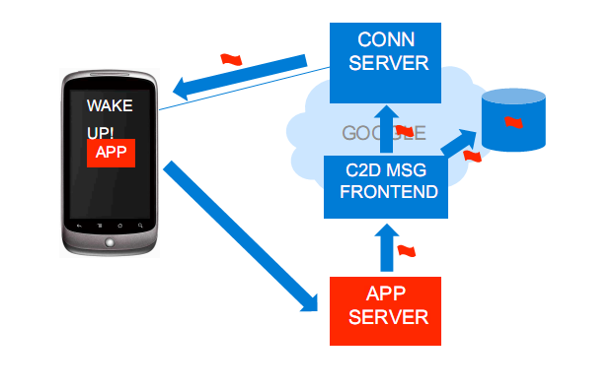
In a nutshell

Slide 21
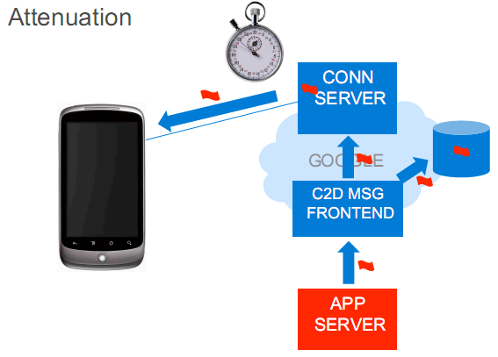
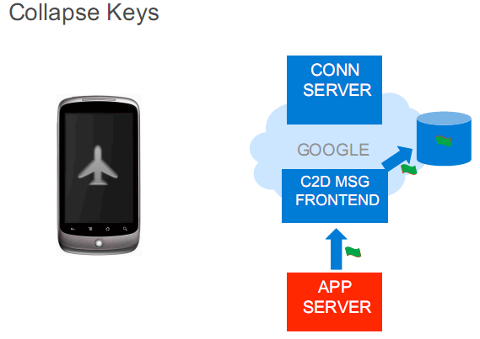
Advantages
Notes:
Collapse Keys
• Latest message replaces older ones with same key
• Avoids message explosion for offline device
• App may use multiple collapse keys
– Correspond to “feed” app will fetch
– Max of four in flight (per device)
• State should be in app server, not in message
– Tell app when it should fetch data

Slide 22
No Stage Courage?

Slide 23
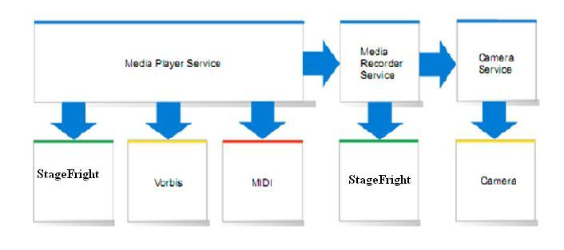
Media Frame work

Slide 24
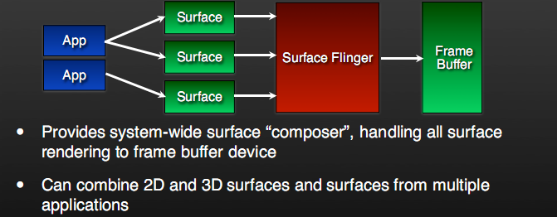
How does all apps put the images on to the screen?

Slide 25
Audio Flinger
Manages all audio output devices
Processes multiple audio streams into PCM audio out paths
Handles audio routing to various outputs

Slide 26
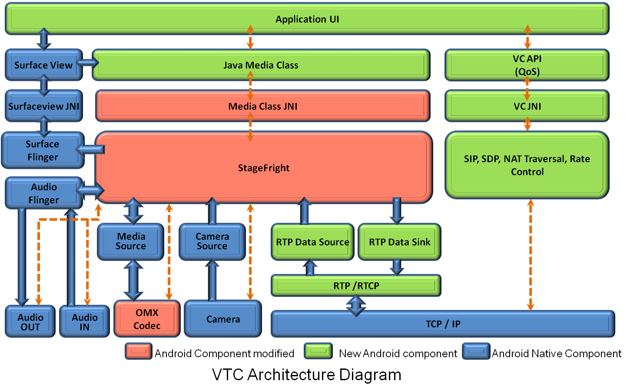
Example of Video Tele Conference
Notes:
1. Encoder framework in StageFright was not complete.
2. Integration of camera service to use OMX encoders.
3. Encoder output to RTP integration.
4. On the decoder side playing video was good. However the challenge was to feed RTP data to decoder. (Buffering issues)
5. Playback was for stage fright and for recording they use open core in 2.2.
6. JNI layer to make sure that the JAVA apps can use the underlying functionality. (Added new classes to handle this).
7. Lack of dual camera support in 2.2.

Slide 27
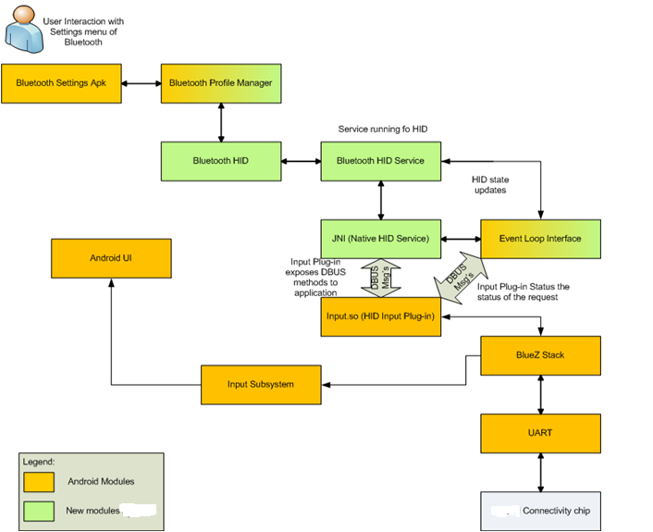
Bluetooth Support in SDK: Example of HID extension
Default profiles supported
HSP
HFP
A2DP/AVRCP
OPP
PBAP

Slide 28
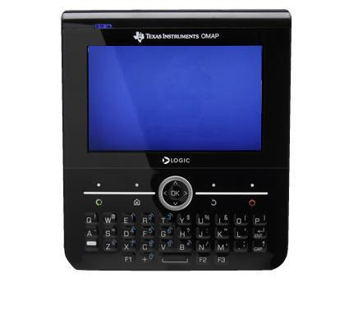
Use case

Slide 29
What is new in Android 2.3
Native NDK improvements
Can receive sensor inputs
Open API for native audio
Activity life cycle and window management etc
Dual camera support
Near field communication (NFC) support (android.nfc)
Internet telephony with full SIP support (android.sip)
New media formats (VP8), audio mixing effects (android.audio.mediafx)
Open core support is completely replaced by Stagefright, AAC encoding and AMR-WB encoding
Further JIT optimizations to DVM
Updated Linux kernel 2.6.35
BlueZ bug fixes

Slide 30
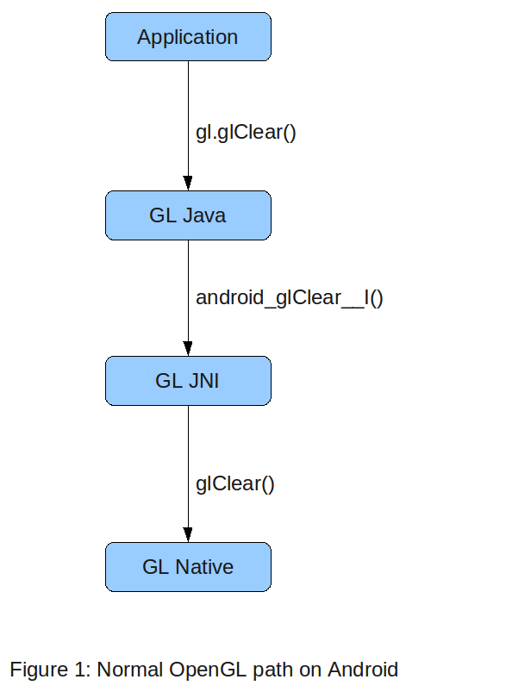
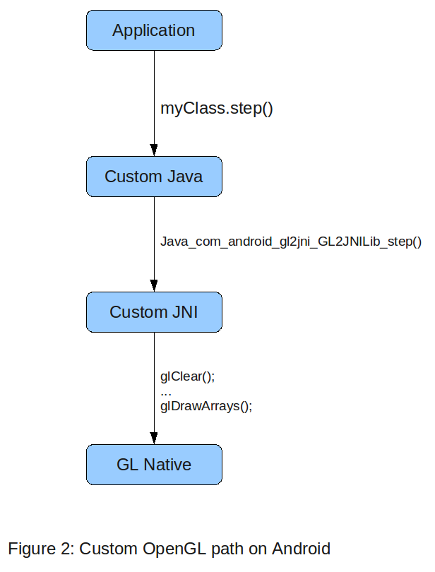
Graphics : OpenGL 2D and 3D
API by Android is similar to the J2ME JSR239 (Java Specification request) OpenGL ES APISupport for Open GL ES 1.0,1.1 and 2.0
Normal path uses Java GL interface and GL JNI
Custom apps sometime avoid GL JNI path

Slide 31
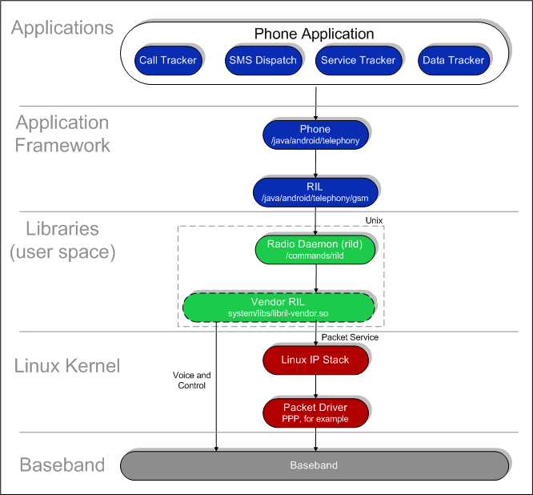
Telephony and RIL

Slide 32
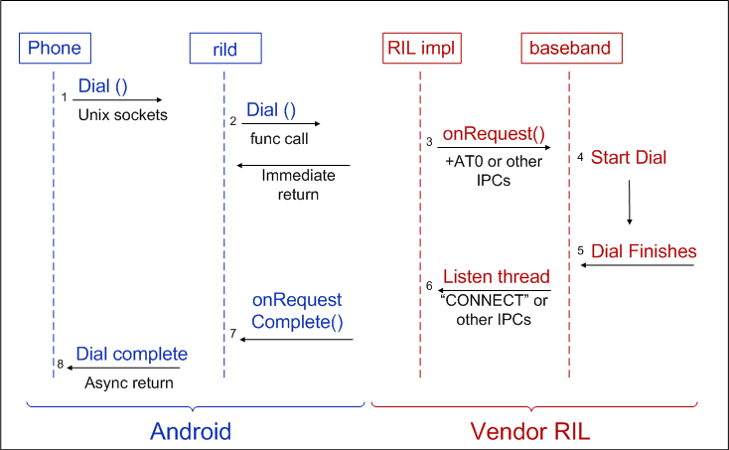
Solicited notifications

Slide 33
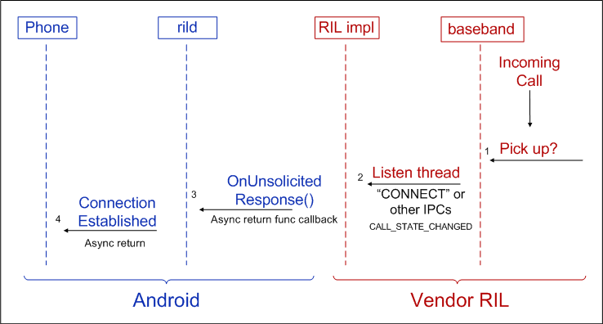
Unsolicited notifications

Slide 34
Many more SDK features
Battery
Notifications, Intents,
Wifi
Location
Etc etc..

Slide 35
Good references
http://sites.google.com/site/io/
http://www.google.com/events/io/2010/
www.google.com/events/io/2009/sessions.html
http://developer.android.com/sdk/index.html
http://code.google.com/android/

Slide 36
Questions

Slide 37
My contact
Gururaj_parvati@mindtree.com

